Slide 1


CREATIVE VENUS

Slide 2

CREATIVE VENUS

Slide 3

CREATIVE VENUS

Slide 4
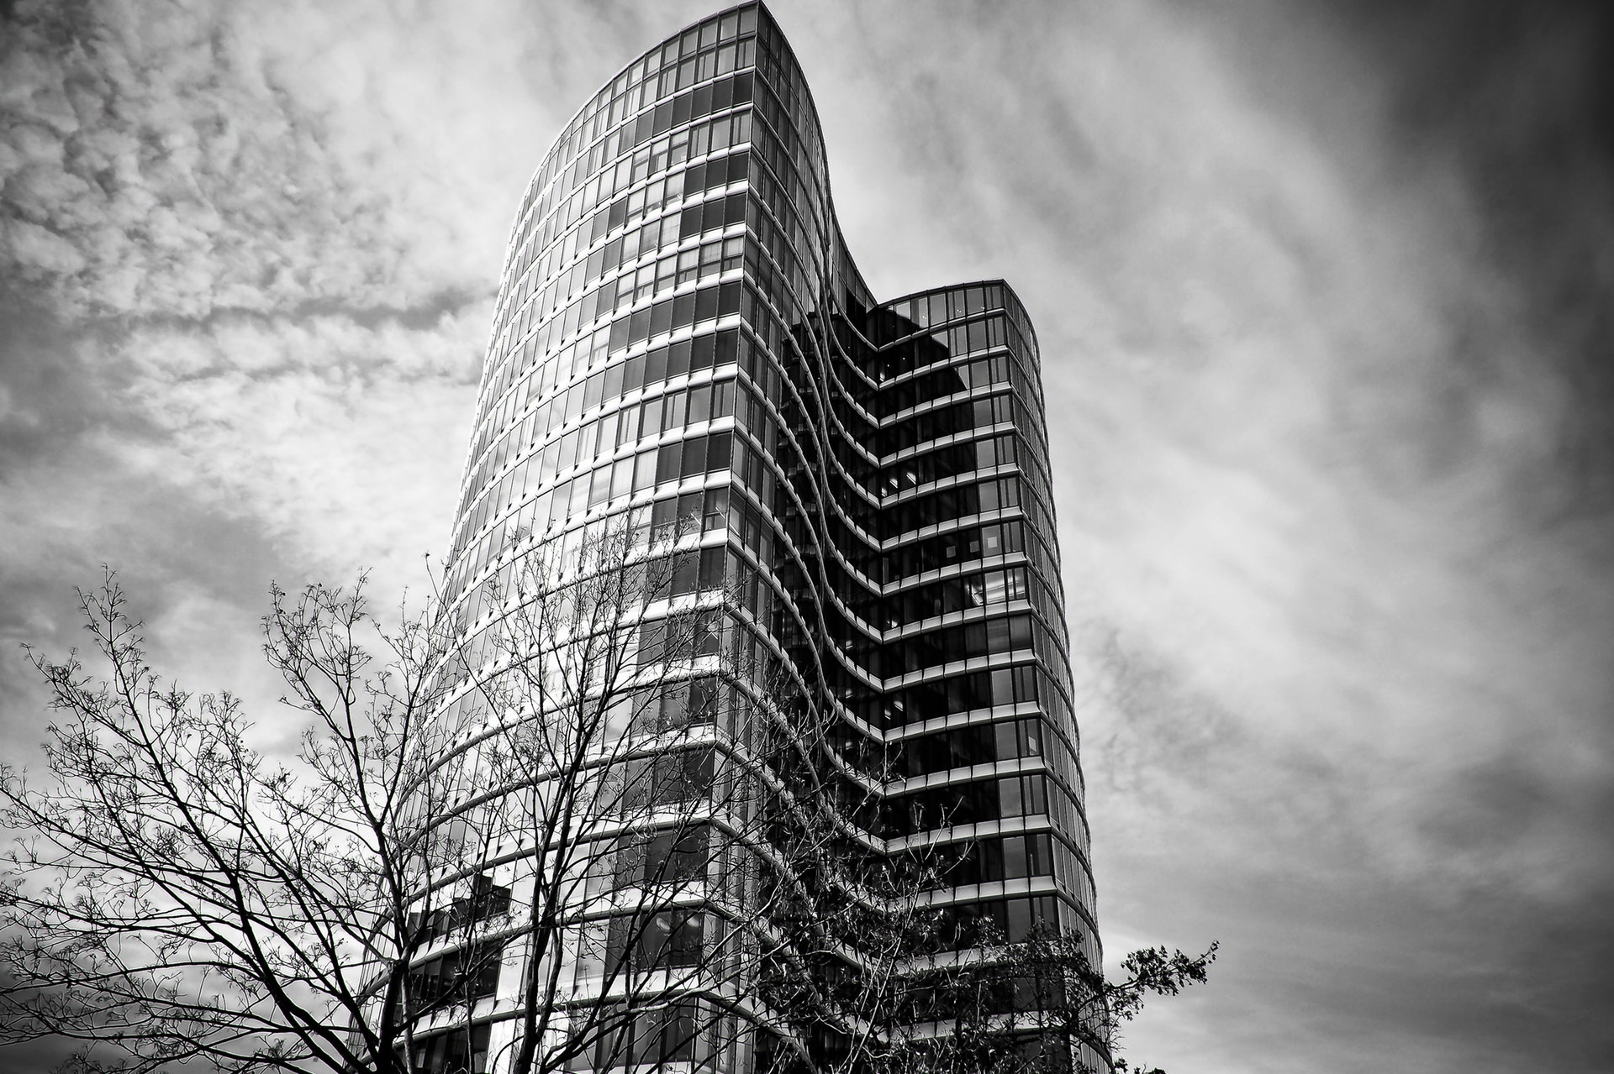
CREATIVE VENUS

Slide 5
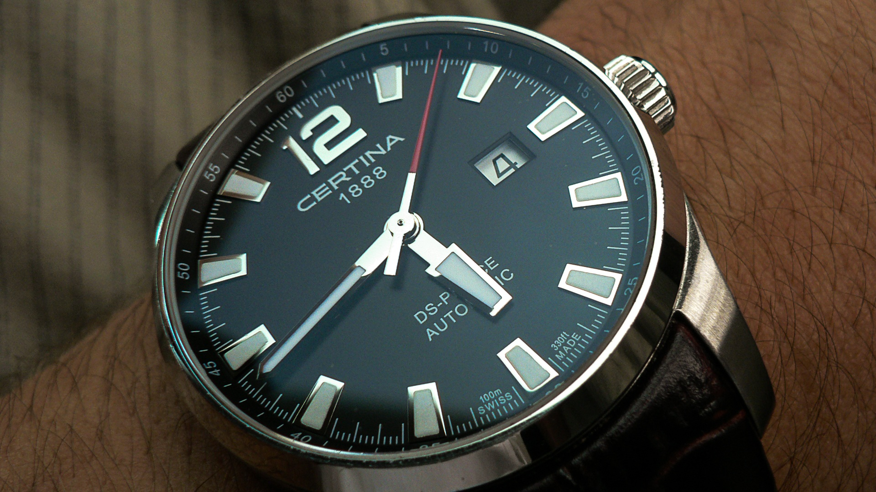
CREATIVE VENUS

Slide 6
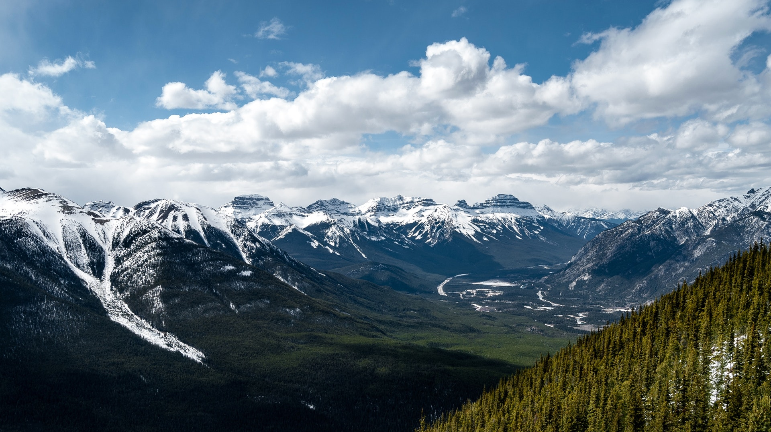
CREATIVE VENUS

Slide 7

CREATIVE VENUS

Slide 8
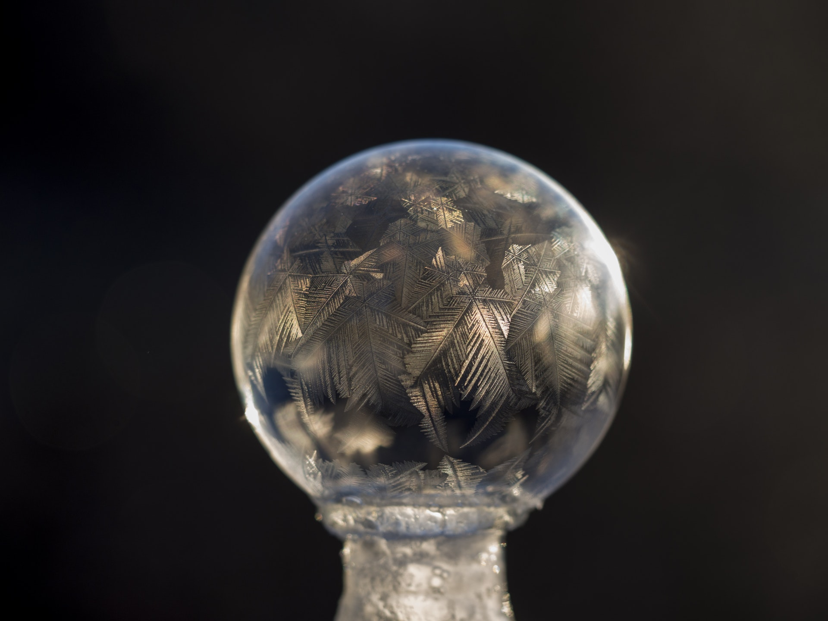
CREATIVE VENUS

Slide 9
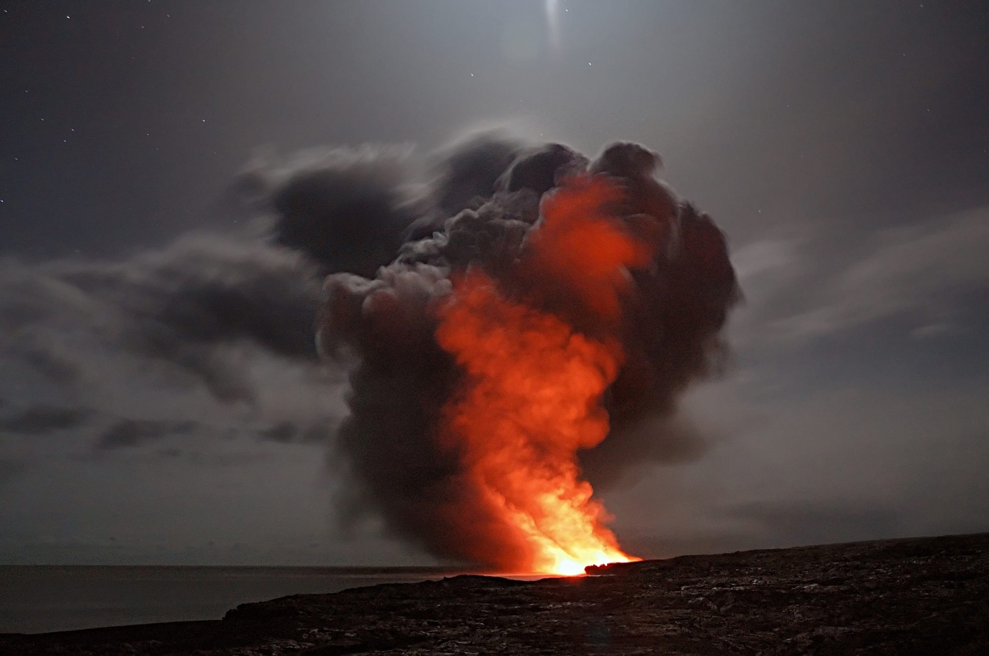
CREATIVE VENUS

Slide 10
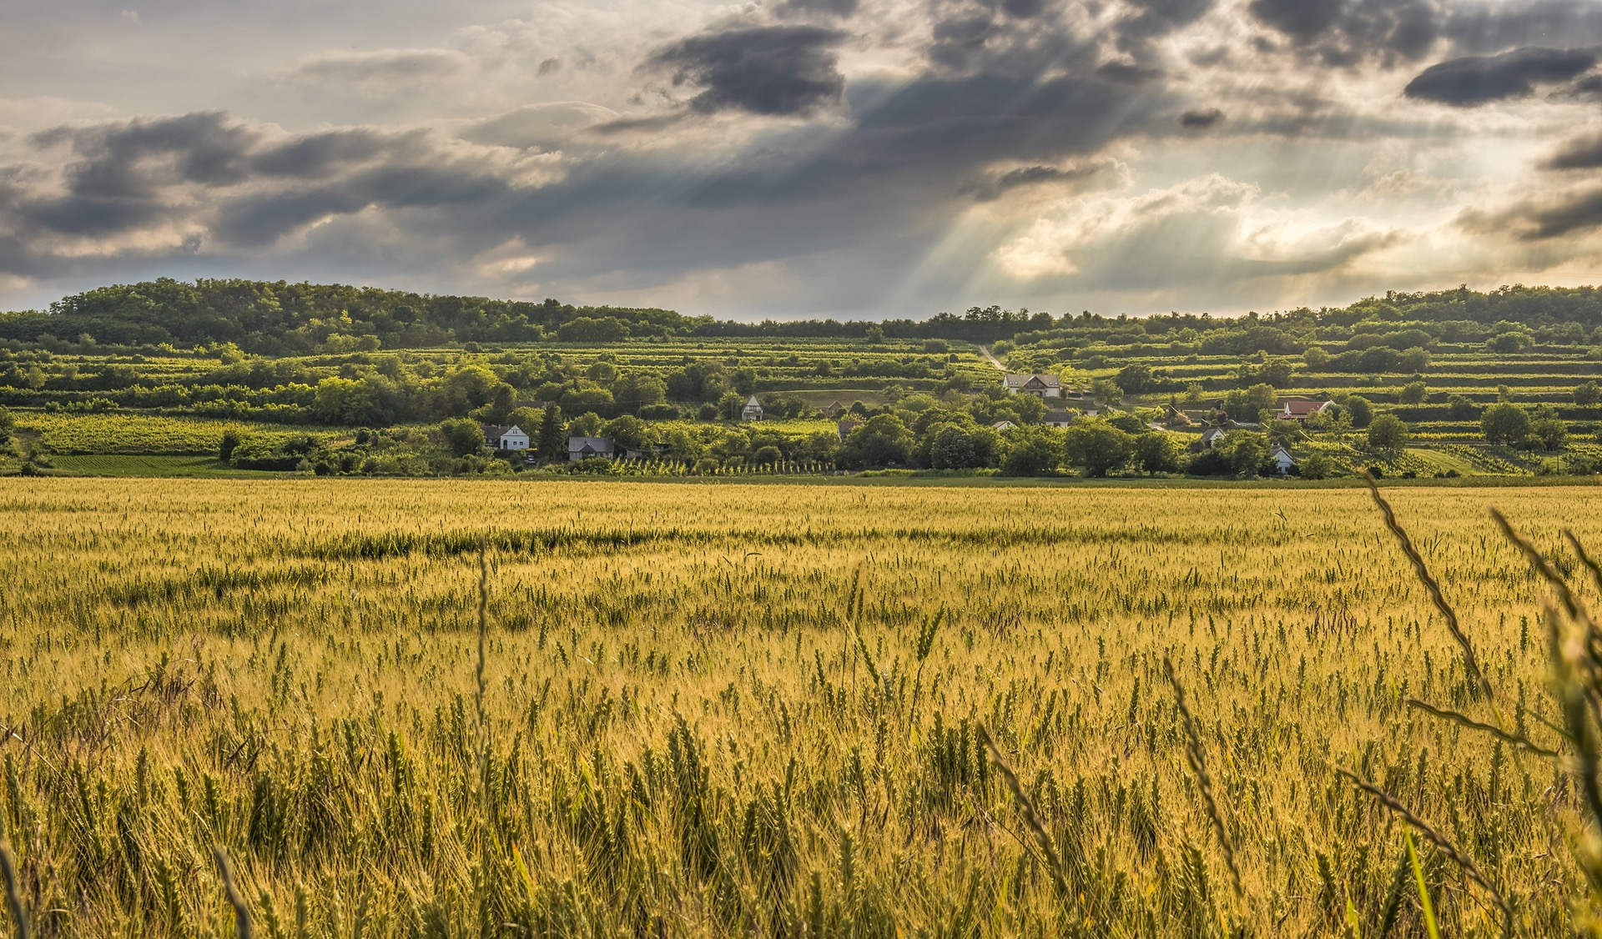
CREATIVE VENUS

Slide 11
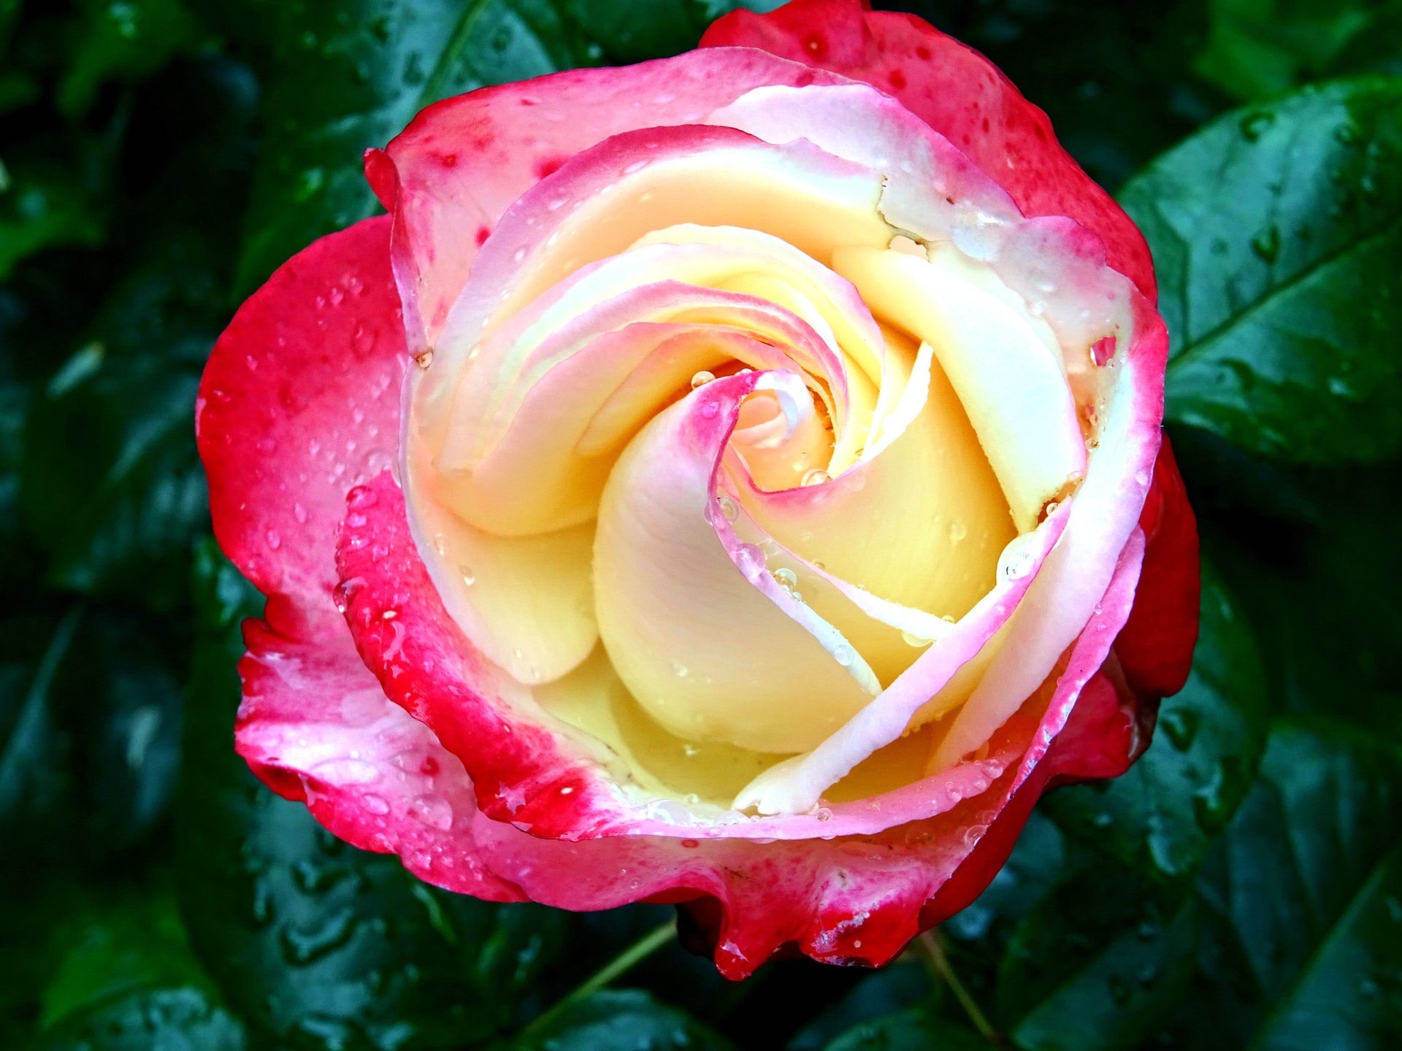
CREATIVE VENUS

